Slide 1


Director
Marketing
Character Designer
Graphic Designer
Daniel Lalanza
Daniel Lazar
Jesús Losada
Daniel Ibáñez

Slide 2
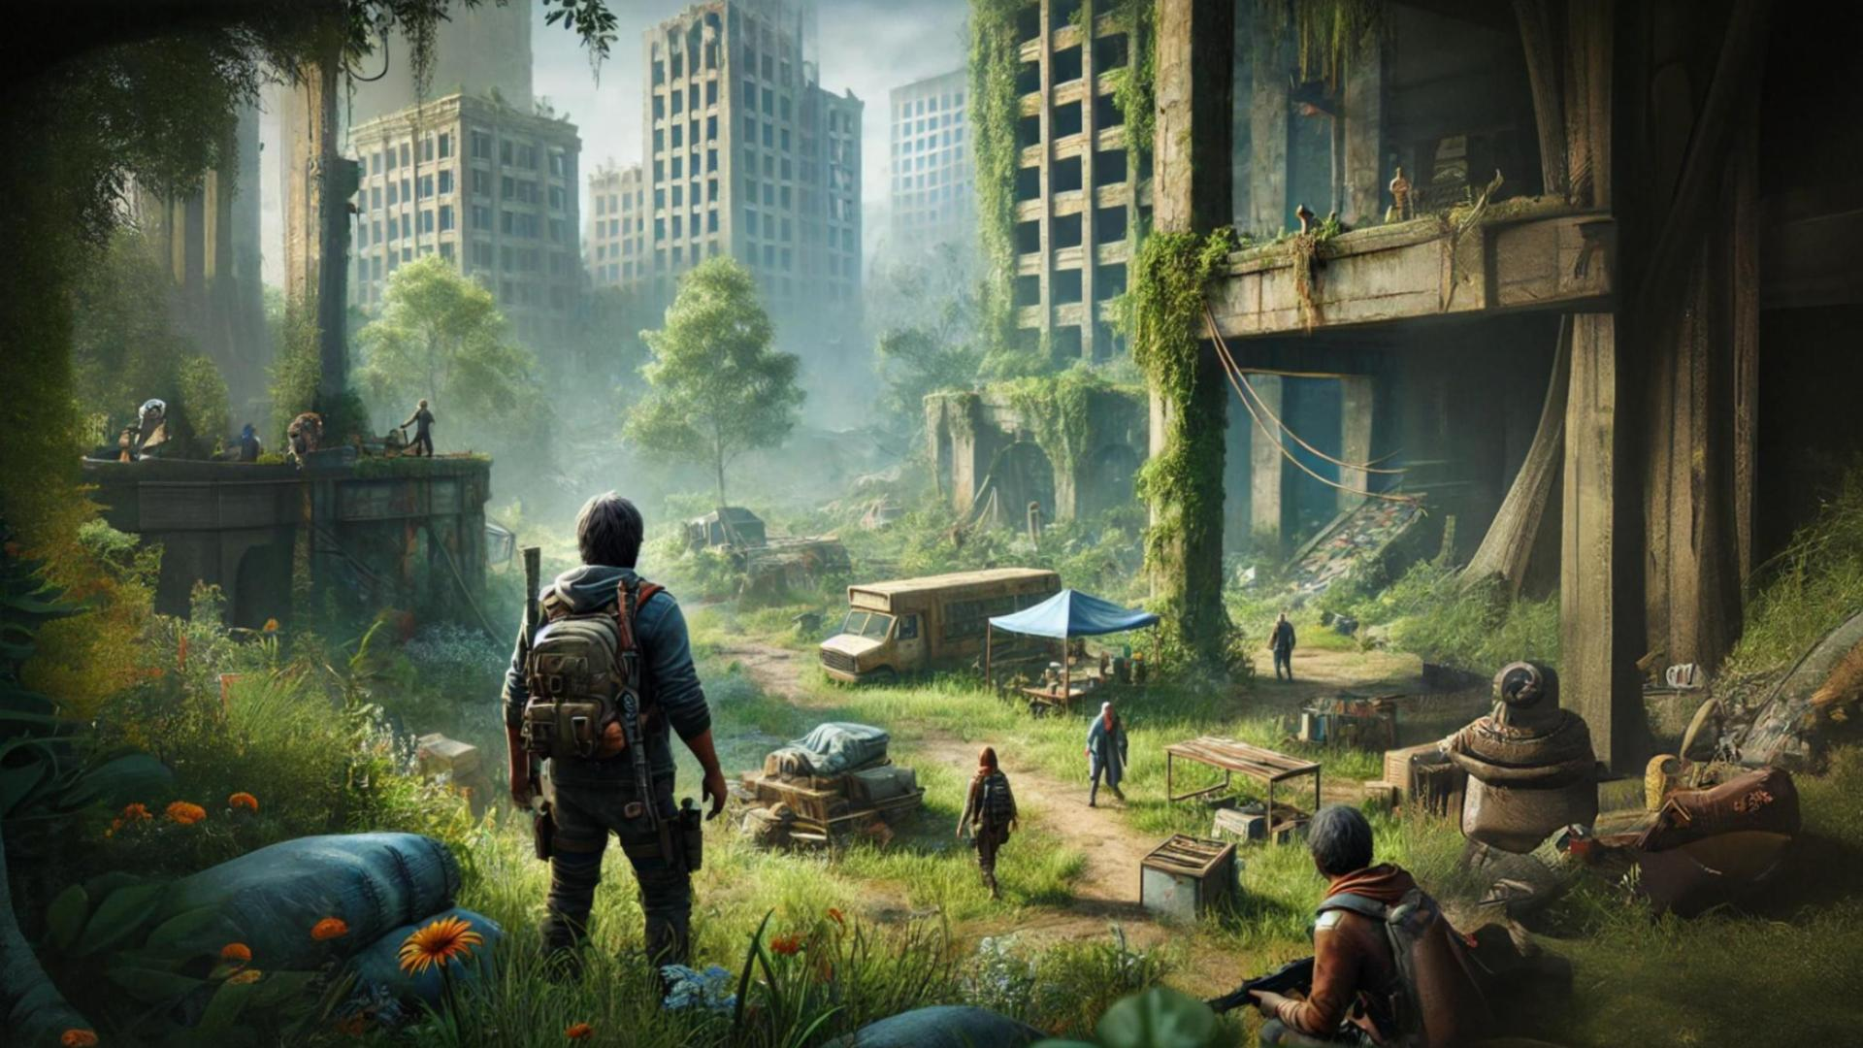
STORY
Notes:
Eco: The Last Haven is set in a world destroyed by environmental collapse.
As a result, humanity is almost extinct, and only small groups of survivors remain.
However there is still hope.
You play as a leader with the mission to rebuild a society in harmony with nature.
Players must balance survival with resource management
to create/build a self-sustaining and secure home.

Slide 3
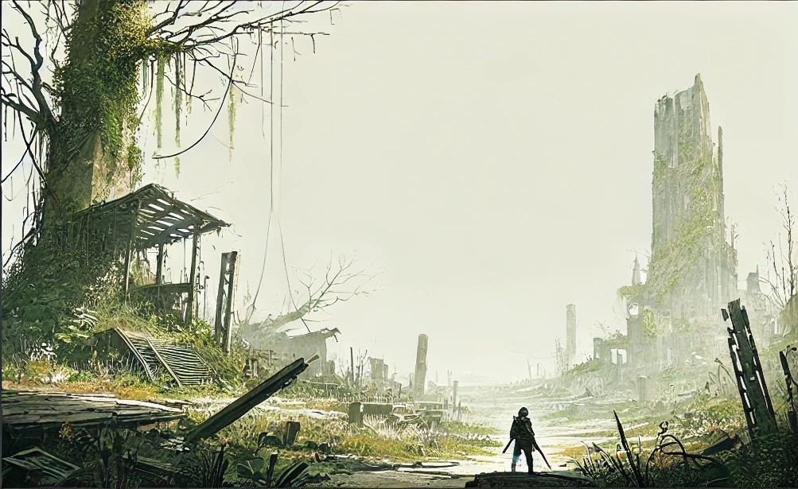
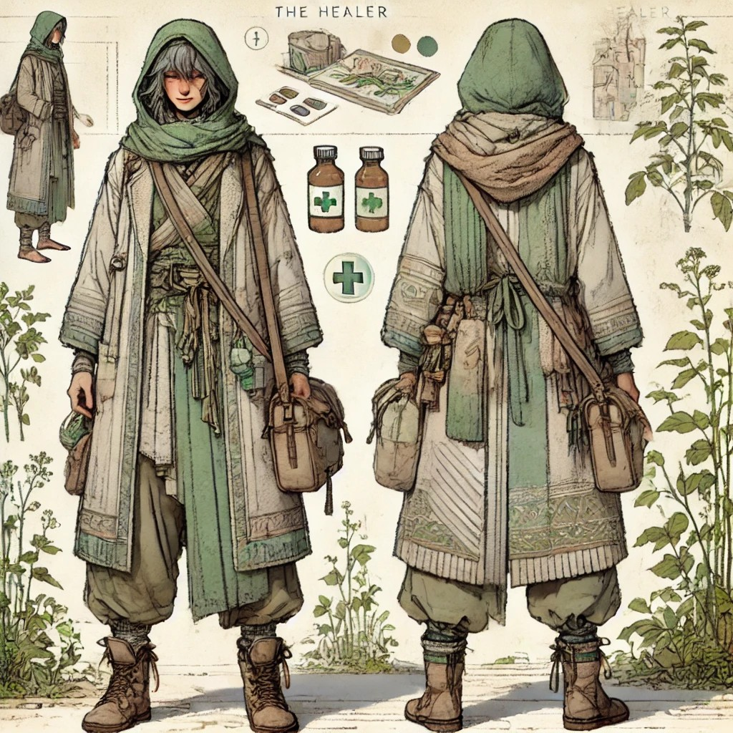
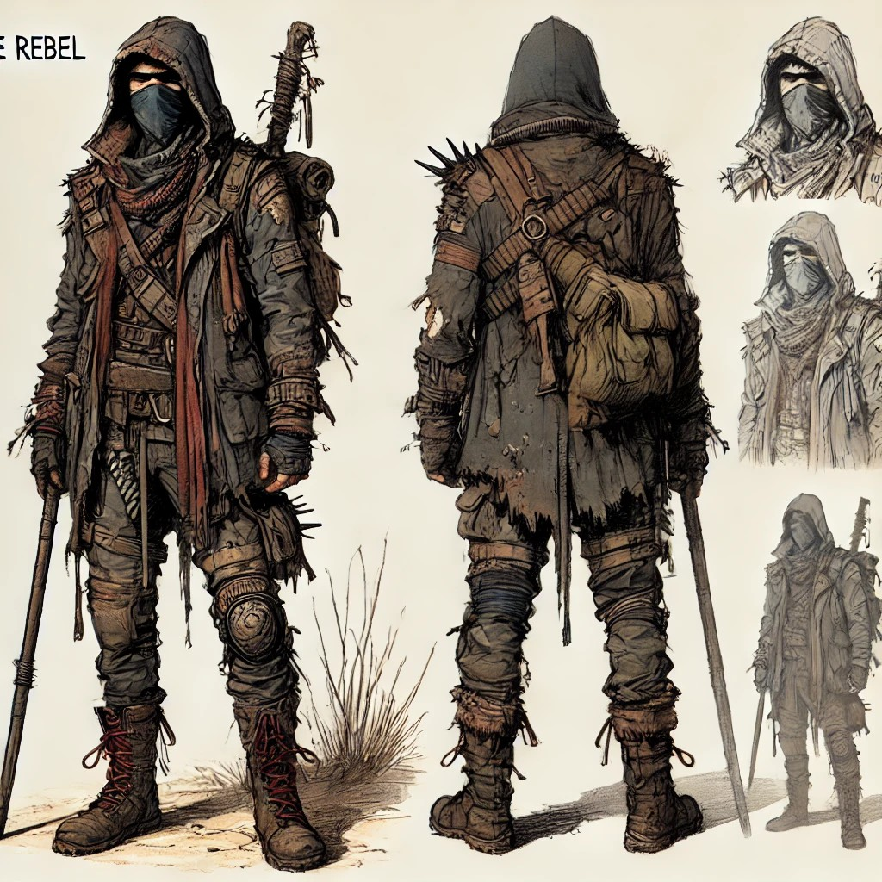



CHARACTERS
CHARACTERS
THE HEALER
THE REBEL
Compassionate
Wise
Supporter
Strengthen ties
Charismatic
Wise
Supporter
Strengthen ties

Slide 4
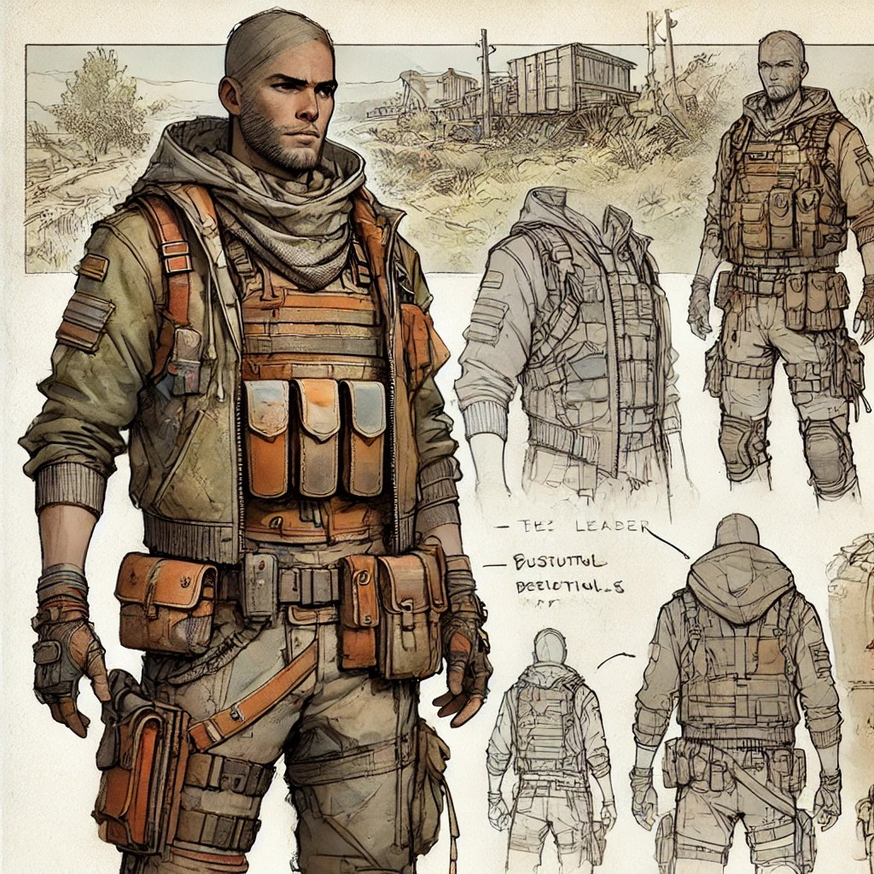
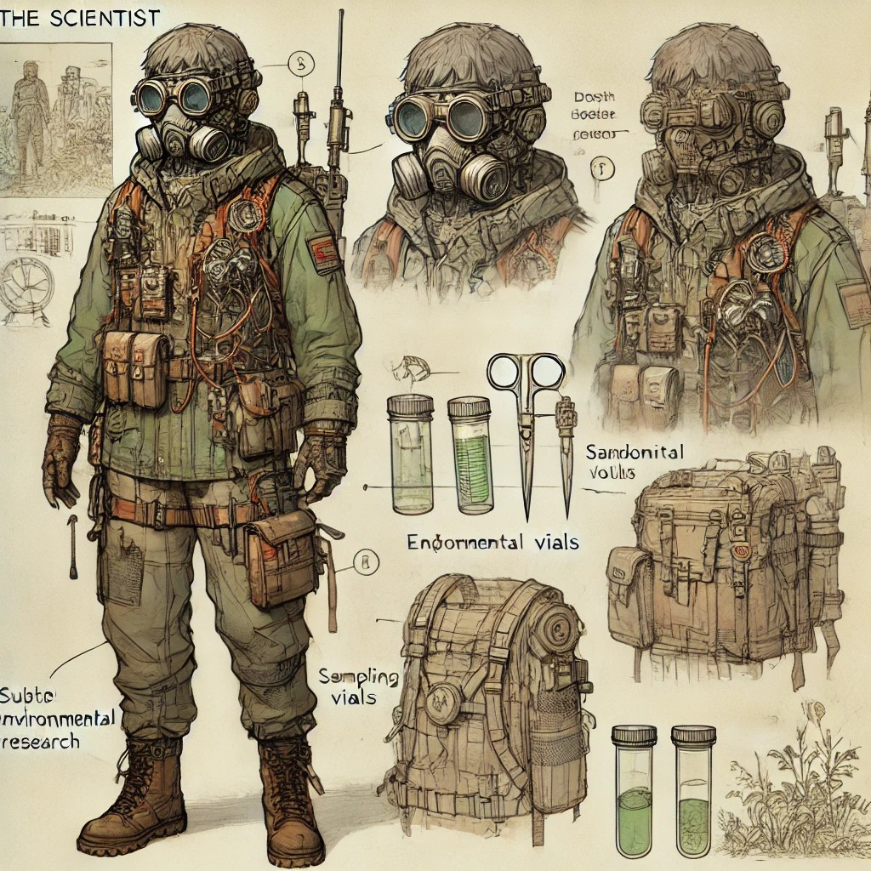


CHRAACTERS
CHARACTERS
THE LEADER
THE SCIENTIST
Resilient
Empathetic
Decision-Maker
Guide
Logical
Inventive
Eco-Friendly
Intelligent

Slide 5
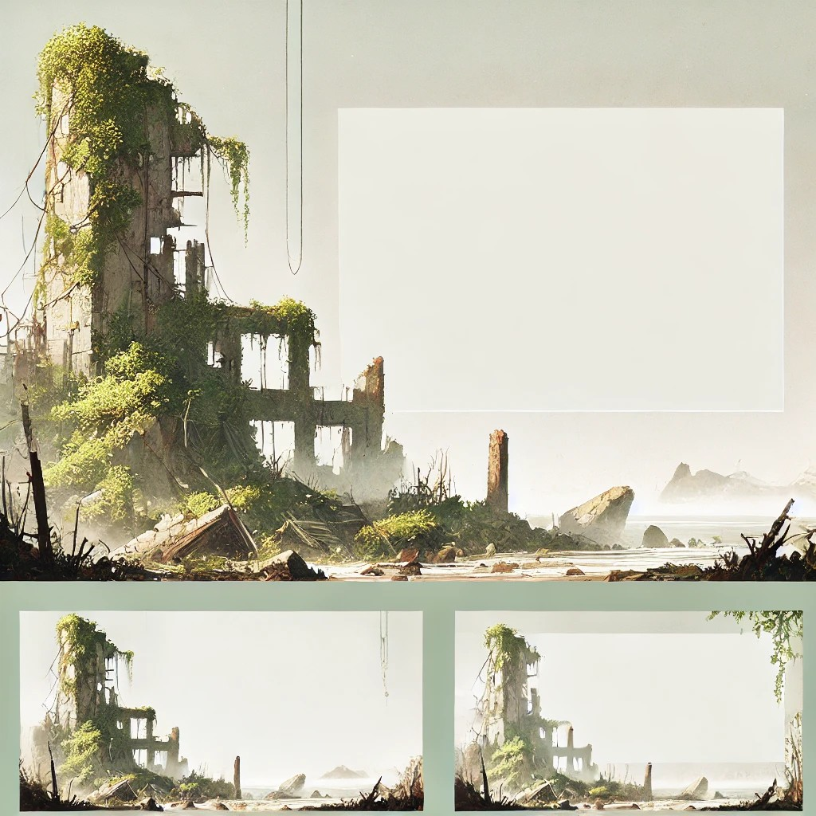


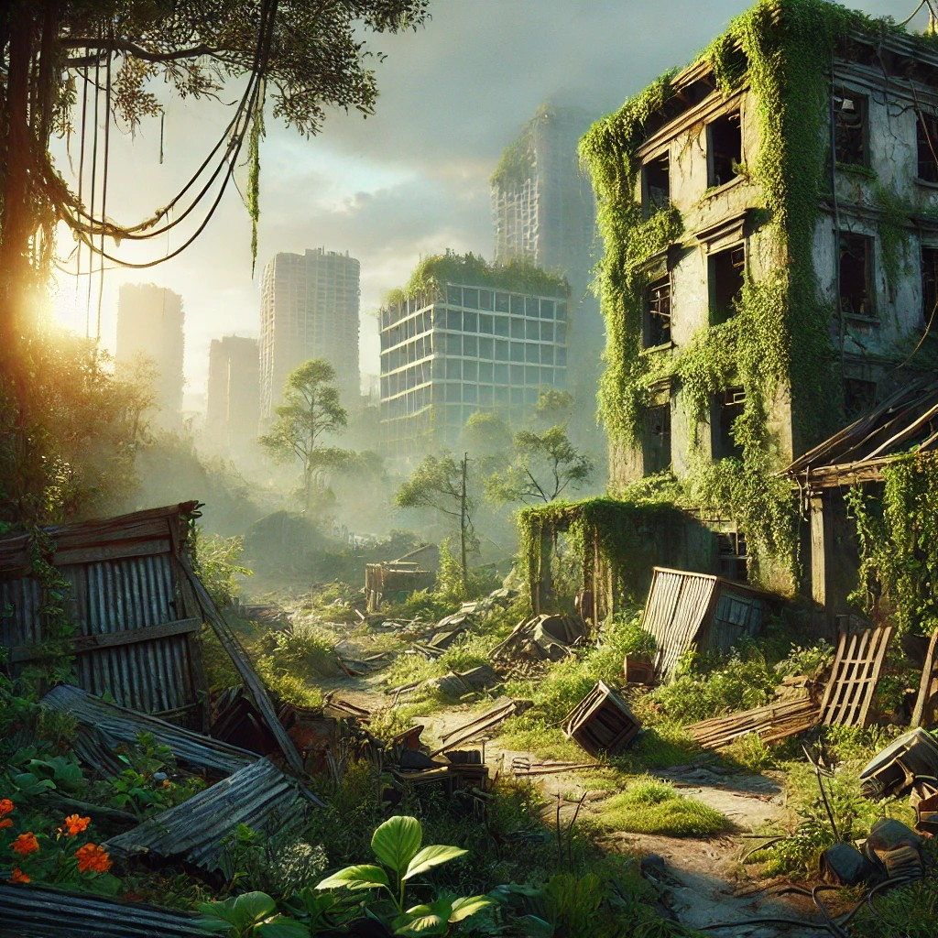

GRAPHIC
DESIGN
Notes:
“Eco: The Last Haven combines realism with soft, hand-painted textures.
The colors are dark, showing the world’s desolation, with green accents symbolizing hope for humanity.
Players will explore abandoned urban areas, forests, and reclaimed environments.
This isn’t just a survival game; It’s an immersive experience that invites players to slow down, appreciate the beauty of nature's resilience, and make choices."

Slide 6

New features
COMING SOON

